Slide 1
Long, Formal Reports

Slide 2


Lesson #4 Overview
Lesson Overview
Lesson Objectives
In week four, students will be able to do the following:
Understand the time required for gathering resources , especially for those topics that are considered serious and/or complex
Understand how to write front matter, text, and back matter for long reports
Write a long report, taking the audience into consideration and enhance discussion with figures and tables for clarity, conciseness, and cosmetic appeal
Use primary research performed and generated to develop content for a long report
Conduct secondary research with already printed and published information for content

Slide 3
What are Long Reports?
Long Reports
If the subject matter is too complex for a short report, only a long report, with research, will convey the content sufficiently and successfully.
Types of long, formal reports include:
Informational
provides information and facts
Analytical
provides information and facts
draws conclusions about the information and facts
Recommendation
provides information and facts
draws conclusions about the information and facts
makes recommendations based conclusions

Slide 4
Major Components of Long Reports
Three major components of long reports:
Front matter
Text
Back matter
Front Matter
Front matter:
Title page
title of the report
name of company
writer(s)
date completed
audience
Cover letter or memo
purpose of writing
importance parts and dates
follow‐up plan
Table of contents
List of illustrations
Abstract and/or executive summary

Slide 5
Major Components of Long Reports (continued)
Text
Text :
Introduction
purpose statement background information
problem
Discussion
majority of report
detailed content
organization
Conclusion/ recommendation
summarize
restate problem
important implications
solutions
benefits
next course of action

Slide 6
Major Components of Long Reports (continued)
Back Matter
Back matter :
Glossary
any high-tech language
abbreviations
acronyms
terms
References (Works Cited)
document all sources used
Appendix
survey results
tables
figures
previous findings
relevant letters or memos

Slide 7
Using Research
Consider:
Use a combination of primary and secondary research to support findings
Combine material from research:
Make a statement
Sentence formatting
Support generalization
material from other sources
quotations
paraphrases
graphics
Provide follow‐up explanations of significance of referenced material
sentences
paragraphs

Slide 8
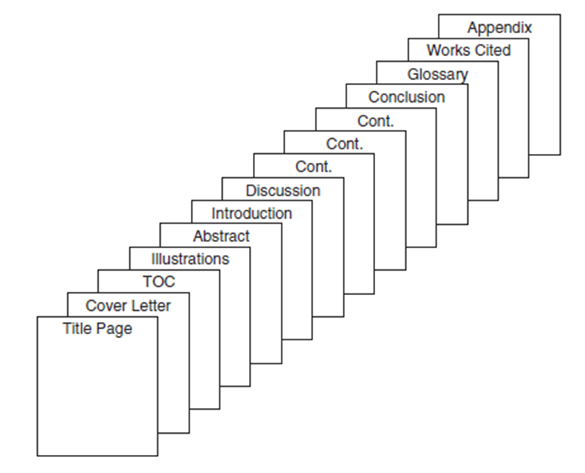
Lesson Review
Wrap-Up
Concepts this week:
Long, formal reports include
front matter (title page, cover letter, table of contents, list of illustrations, and abstract)
text (introduction, discussion, conclusion/recommendation)
back matter (glossary, works cited, and optional appendix)
Additional Information
For additional information regarding correct citing, please visit:
http://www.apastyle.org/learn/tutorials/basics-tutorial.aspx
http://www.ieee.org/documents/ieeecitationref.pdf
**Be sure to look forward for assignments that can be started/completed now

